Slide 1

Apache Ivy
Dima Ionut Daniel

Slide 2
Contents
What is Apache Ivy ?
History
Features
Architecture
Core
Ant Tasks
Bibliography

Slide 3

What is Apache Ivy ?
Apache Ivy is a transitive dependency manager.
It is a sub-project of the Apache Ant project, with which Ivy works to resolve project dependencies.
An external XML file defines project dependencies and lists the resources necessary to build a project.
Ivy then resolves and downloads resources from an artifact repository: either a private repository or one publicly available on the Internet.

Slide 4
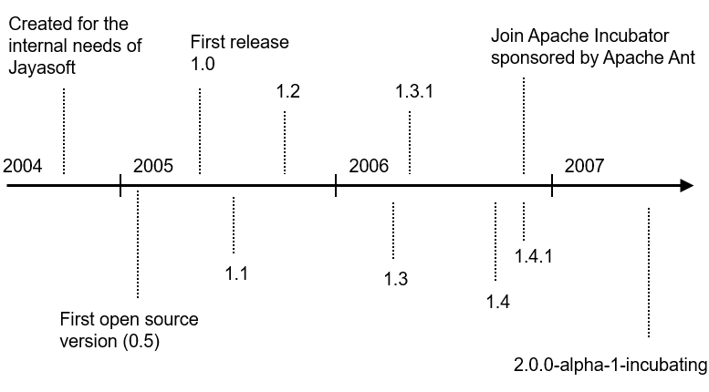
History

Slide 5
Features
Dependency manager
Artifact repository
Dependency resolution, including transitive
Sync with external repositories
XML-driven declaration of project dependencies and JAR repositories
Publishing of artifacts into a local enterprise repository

Slide 6
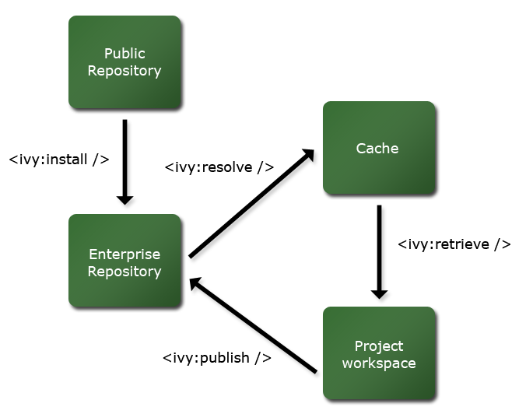
Architecture

Slide 7
Core
Module dependencies are declared in ivy.xml
<ivy-module version="2.0"
xmlns:xsi="http://www.w3.org/2001/XMLSchema-instance">
<info organisation=“org.myGroup" module=“myModule"/>
<dependencies>
<dependency org="org.apache" name="ant" rev="1.7.0"/>
<dependency org="org.apache" name="axis" rev="1.2rc3"/>
<dependency org="org.junit" name="junit" rev="4.4"/>
</dependencies>
</ivy-module>

Slide 8
Core (cont.)
Add this to your Ant buildfile (build.xml)
<project xmlns:ivy="antlib:org.apache.ivy.ant" name="pdk" default="default" basedir=".">
…
<!-- Ivy Taskdefs -->
<path id="ivy.lib.path">
<fileset dir="C:/tools/apache-ivy-2.0.0" includes="*.jar"/>
</path>
<taskdef resource="org/apache/ivy/ant/antlib.xml" uri="antlib:org.apache.ivy.ant" classpathref="ivy.lib.path"/>
<!-- Reference Ivy settings -->
<ivy:settings file="${basedir}/../ivysettings.xml"/>
<target name="ivy.resolve" description="--> retrieve dependencies with ivy">
<ivy:retrieve pattern=“${lib.dir}/[conf]/[artifact].[ext]”/>
</target>
<target name="ivy.publish" description="--> publish artifacts to local repository">
<ivy:publish resolver=“local” pubrevision=“${version}”>
<artifacts pattern=“dist/[artifact].[ext]”/>
</ivy:publish>
</target>

Slide 9
Core (cont.)
The organization is either a company, an individual or a group of people producing software.
A module is a self-contained, reusable unit of software that as a whole unit follows a revision control scheme.
Ivy is only concerned about the module deliverables known as artifacts and the module descriptor that declares them.
These deliverables, for each revision of the module are managed in repositories.

Slide 10
Core (cont.)
A module descriptor is a generic way of identifying what describes a module: the identifier, the published artifacts, possible configurations and their dependencies.
The common module descriptors in Ivy are Ivy Files, xml files with an Ivy specific syntax called ivy.xml.
An artifact is a single file ready for delivery with the publication of a module revision.
The artifact type is a category of a particular kind of artifact specimen.

Slide 11
Core (cont.)
A module configuration is a way to use or construct a module.
if the same module has different dependencies based on how it's used, those distinct dependency-sets are called its configuration in Ivy.
A module may need some others modules and artifacts only at build time and some others at runtime.
Ivy settings files are xml files used to configure ivy to indicate where the modules can be found and how.

Slide 12
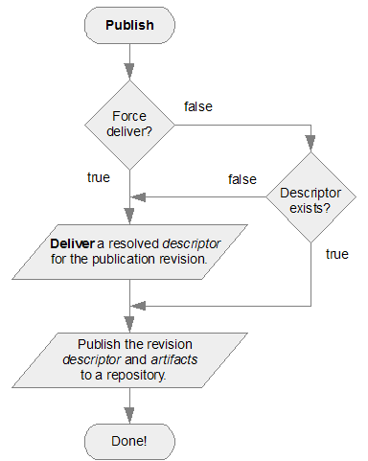
Ant Tasks
Publish: publishes the current module's artifacts and the resolved descriptor.
The task is meant to publish the current module descriptor with its declared publication artifacts to a repository. All the artifacts must have been created before calling this task.

Slide 13
Ant Tasks (cont.)
Retrieve: copies resolved dependencies anywhere on the file system.
This is a post resolve task with all the behavior and attributes common to all post resolve tasks.
Var: sets a variable (by name and value), or set of variables.
Variables are case sensitive.
Contrary to ant properties, ivy variables are mutable.

Slide 14
Ant Tasks (cont.)
Resolve: resolves dependencies described in an ivy file and put the resolved dependencies in the ivy cache.
If configure has not been called before resolve is called, a default configuration will be used.
Report: generated reports of dependency resolving. One report per configuration is generated, but all reports generated together are hyperlinked one to each other.
This task should be used only after a call to resolve, even if the call was not done during the same ant build.

Slide 15
Ant Tasks (cont.)
Configure: used to configure ivy with an xml settings file.
Info: ease the access to some essential data contained in an ivy file without performing a dependency resolution.
Listmodules: finds the list of modules in the repository matching some criteria and set a corresponding list of properties in ant.
The criteria is set by given patterns matching the organization, name branch and revision of the modules to find.
Cleancache: cleans the Ivy cache.

Slide 16

Bibliography
http://ant.apache.org/ivy/
https://en.wikipedia.org/wiki/Apache_Ivy

